Slide 1
CLM Tools Overview
TechMahindra
Confidential © Tech Mahindra 2012

Slide 2
Objectives
Application Life Cycle Management(ALM)
Collaborative Lifecycle management (CLM)
Rational Solution for CALM
IBM Jazz architecture
Rational CLM tools on Jazz

Slide 3
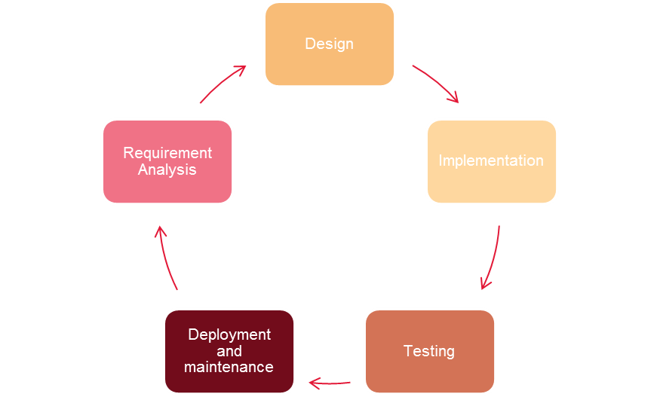
Application Lifecycle Management
Typical SDLC Phases involves -
Application Lifecycle Management is the co-ordination of all the activities spanning across these phases.
ALM Tools provides platform for implementing SDLC processes , collaborating the entire development cycle and tracing the implementations to the requirements.
Collaboration & Automation

Slide 4
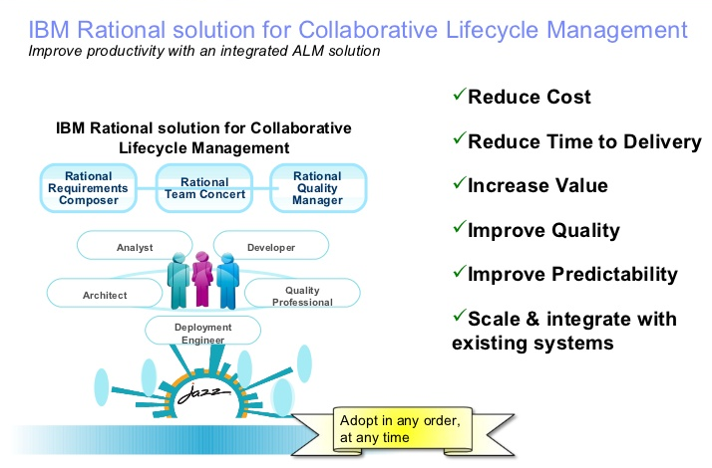
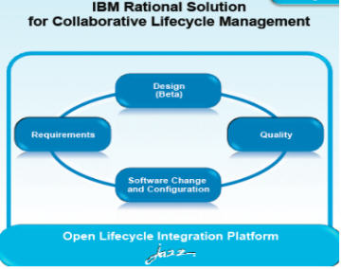
Collaborative Lifecycle Management (CLM)

Slide 5
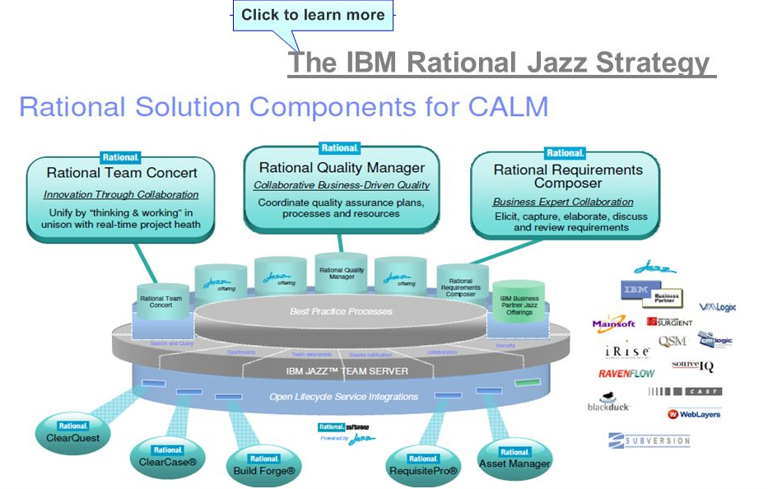
Rational solution for CALM

Slide 6
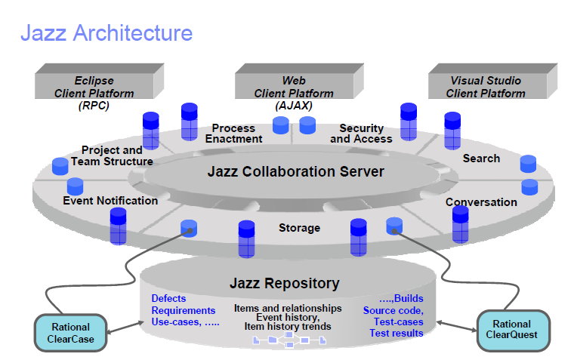
IBM Jazz Architecture

Slide 7
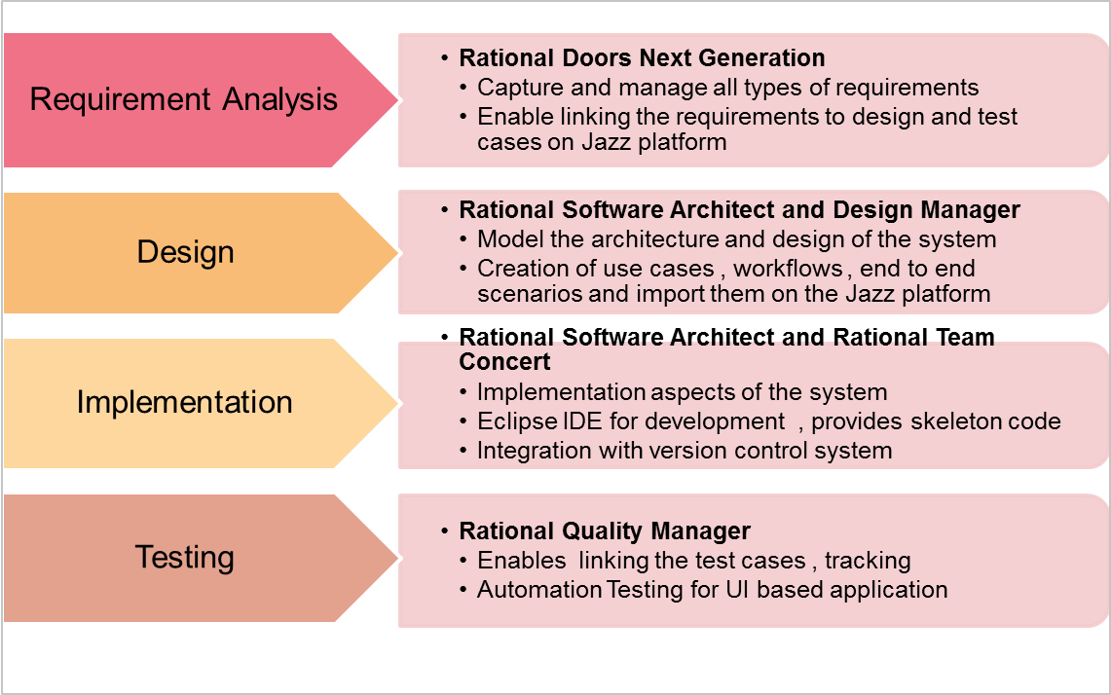
Rational CLM Tools on Jazz suite
TechM uses Rational CLM Suite which is best in industry for Application and collaborative Lifecycle Management
This is the illustration of Rational CLM Tools with respect to SDLC

